Slide 1
OLTP VS OLAP

Slide 2
OLTP (On-line Transaction Processing)
is characterized by a large number of short on-line transactions (INSERT, UPDATE, DELETE).
The main emphasis for OLTP systems is put on very fast query processing, maintaining data integrity in multi-access environments and an effectiveness measured by number of transactions per second.
In OLTP database there is detailed and current data, and schema used to store transactional databases is the entity model (usually 3NF).

Slide 3
OLAP (On-line Analytical Processing)
is characterized by relatively low volume of transactions.
Queries are often very complex and involve aggregations.
For OLAP systems a response time is an effectiveness measure.
OLAP applications are widely used by Data Mining techniques.
In OLAP database there is aggregated, historical data, stored in multi-dimensional schemas (usually star schema).

Slide 4
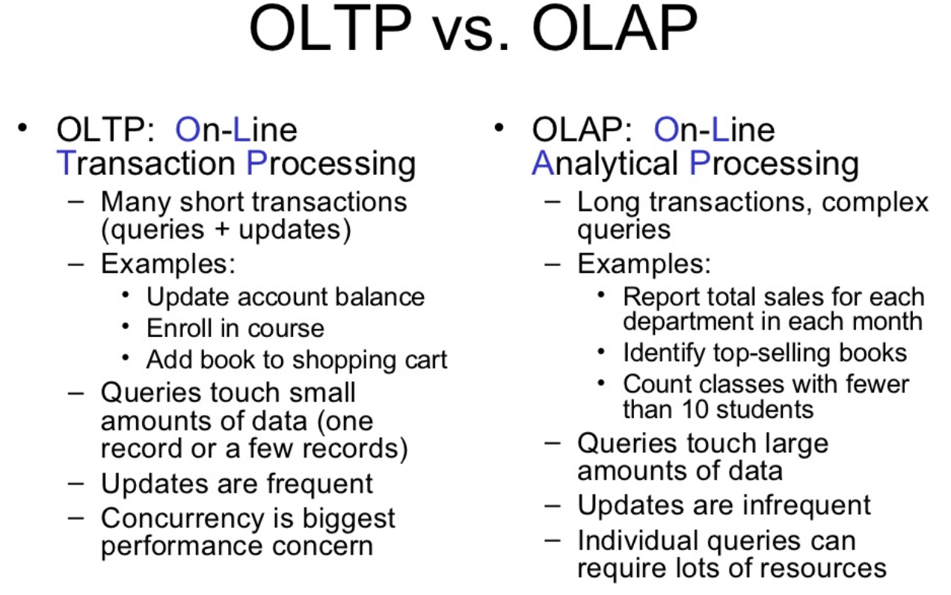

Slide 5
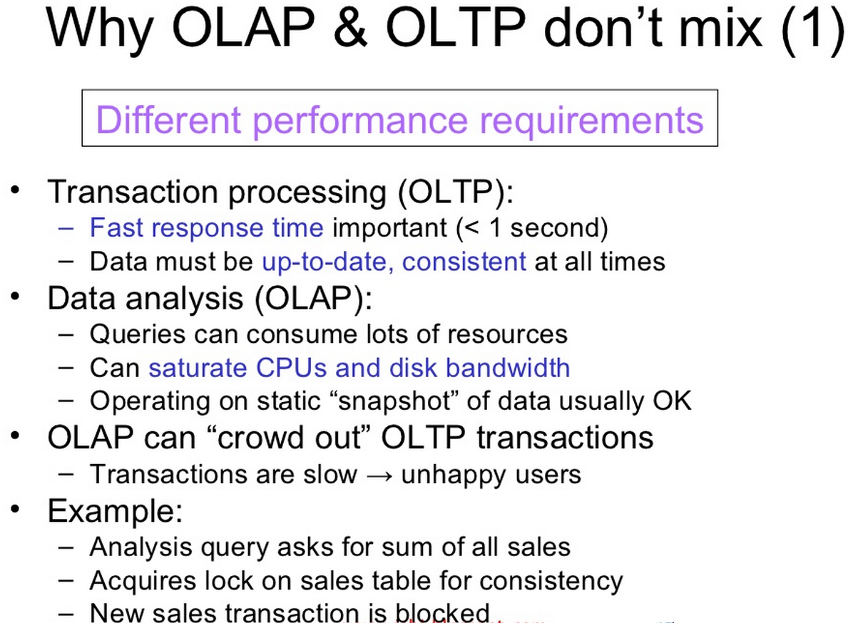

Slide 6
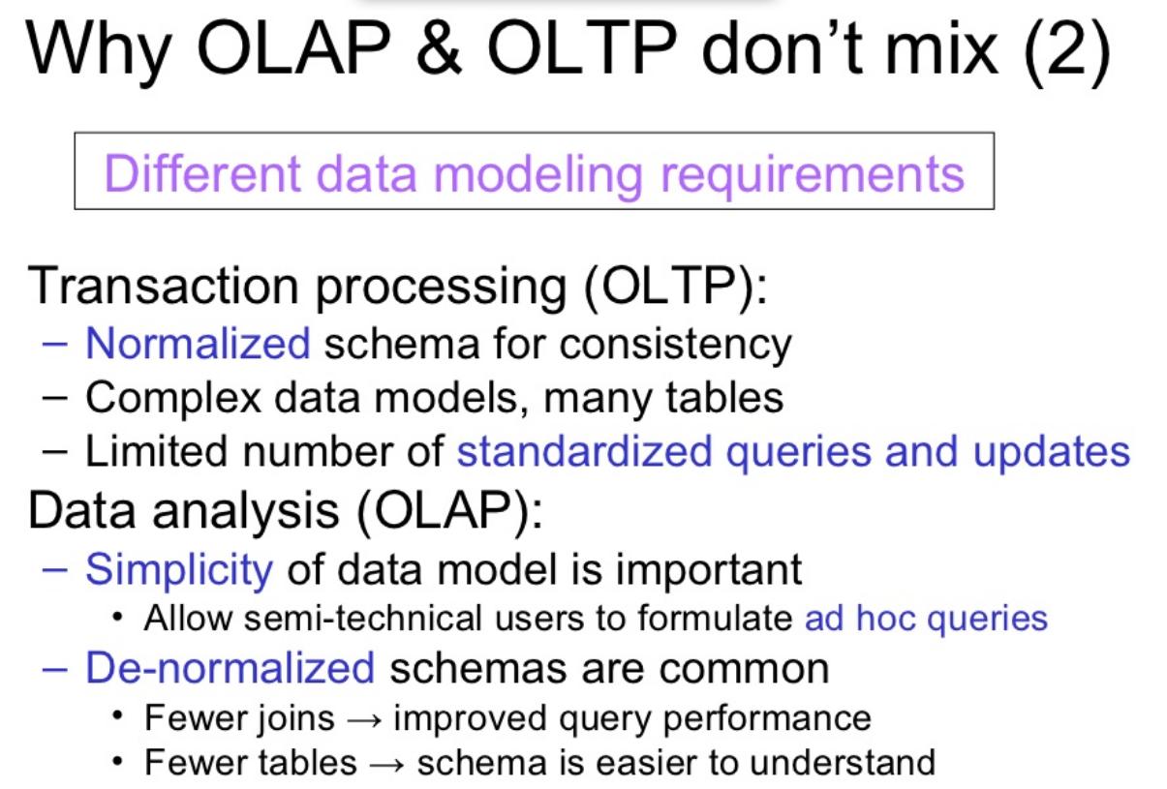

Slide 7
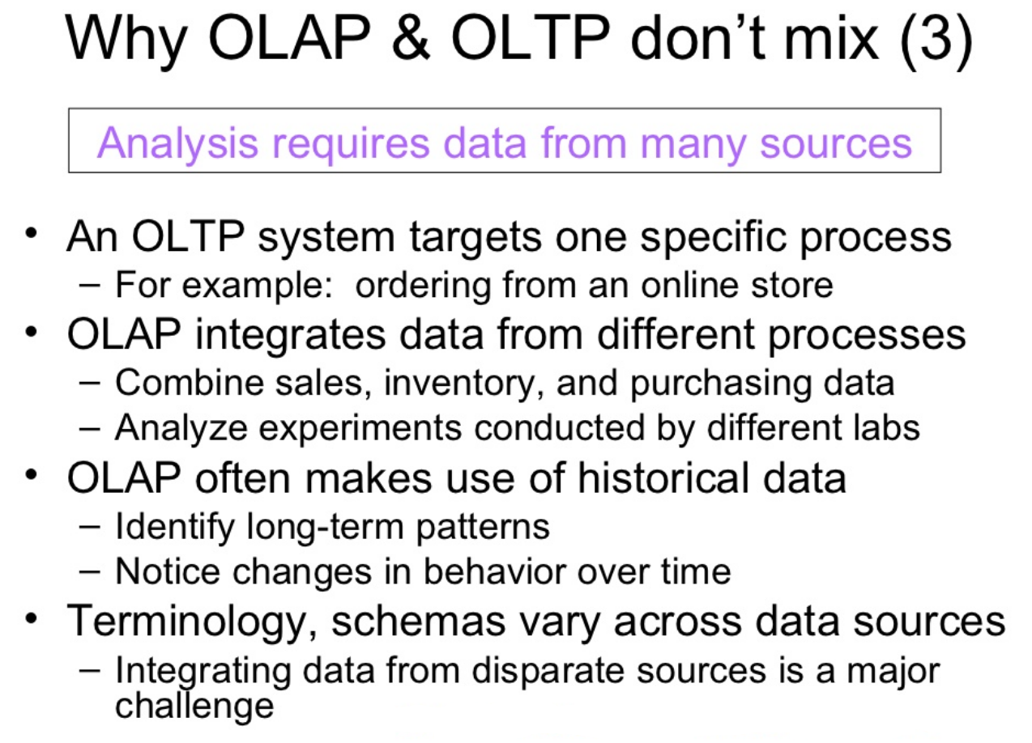

Slide 8
DATA WAREHOUSING AND OPERATIONAL DBMS

Slide 9
What is Data Warehousing?

Slide 10
Definition:
A data warehouse is a copy of transaction data specifically structured for querying and reporting.
An expanded definition for data warehousing includes business intelligence tools, tools to extract, transform and load data into the repository, and tools to manage and retrieve metadata.

Slide 11
The form of the stored data has nothing to do with whether something is a data warehouse.
This definition of the data warehouse focuses on data storage.
A data warehouse can be normalized or denormalized.
It can be a relational database, multidimensional database, flat file, hierarchical database, object database, etc.
Data warehouse data often gets changed.
And data warehouses often focus on a specific activity or entity.

Slide 12
Why Do We Need Data Warehouses?
Consolidation of information resources
Improved query performance
Separate research and decision support functions from the operational systems
Foundation for data mining, data visualization, advanced reporting and OLAP tools

Slide 13
The data stored in the warehouse is uploaded from the operational systems.
The data may pass through an operational data store for additional operations before it is used in the DW for reporting.
Operational DBMS is used to deal with the everyday running of one aspect of an enterprise.
OLTP (on-line transaction processor) or Operational DBMS are usually designed independently of each other and it is difficult for them to share information.

Slide 14
How Do Data Warehouses Differ From Operational DBMS?
Goals
Structure
Size
Performance optimization
Technologies used

Slide 15
How Do Data Warehouses Differ From Operational Systems?
Data warehouse | Operational DBMS
Subject oriented | Transaction oriented
Large (hundreds of GB up to several TB) | Small (MB up to several GB)
Historic data | Current data
De-normalized table structure (few tables, many columns per table) | Normalized table structure (many tables, few columns per table)
Batch updates | Continuous updates
Usually very complex queries | Simple to complex queries

Slide 16
Design Differences
Operational DBMS
Data Warehouse
ER Diagram
Star Schema

Slide 17
Functions
A data warehouse maintains its functions in three layers: staging, integration, and access.
Staging is used to store raw data for use by developers (analysis and support).
The integration layer is used to integrate data and to have a level of abstraction from users.
The access layer is for getting data out for users.

Slide 18
What Is a Data Warehouse Used for?
Knowledge discovery
Making consolidated reports
Finding relationships and correlations
Data mining
Examples
Banks identifying credit risks
Insurance companies searching for fraud
Medical research

